Slide 1
Stock Market Analysis
Zachary Herrington, Molly Oesterling, Tomorrow Rose, Chris Wycott

Slide 2
Our Data
Historical stock price data for technology stocks
New York Stock Exchange (NYSE) | London Stock Exchange (LSE) | Over the Counter Markets (OTCMKTS)
Apple (AAPL) | Sage Group (SGE.L) | Infineon Technologies (IFNNY)
Microsoft (MSFT) | Vodafone Group (VOD.L) | Aac Technologies Holdings (AACAF)
Google (GOOG) | Micro Focus International (MCRO) | Techtronic Industries (TTNDF)

Slide 3
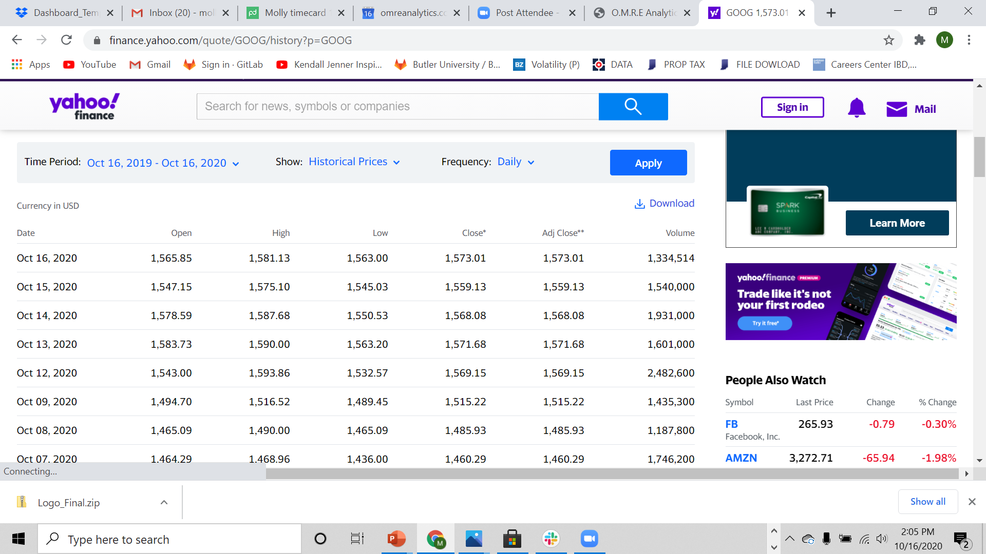
Data Source
Yahoo Finance Historical Stock Market Data

Slide 4
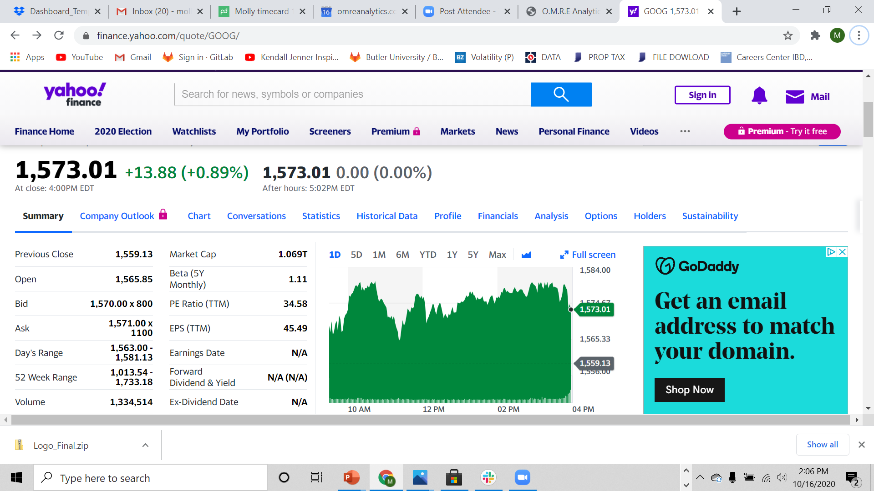
Data Visuals Inspiration

Slide 5
Project Overview
Database – MongoDB
Class - Dashboard with multiple charts that update from the same data
New JS Library – Chart.js
Over 100 Records – Yes
User Driven Interface – Drop down selection to choose a stock from each stock exchange
Three Views – Yes. One for a given stock on each of the three stock exchanes

Slide 6
Our Process
Obtain historical stock market data from Yahoo Finance

Slide 7
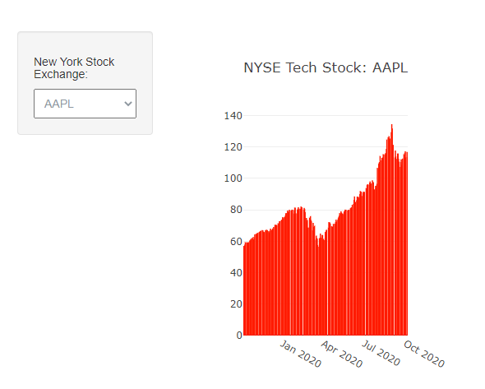
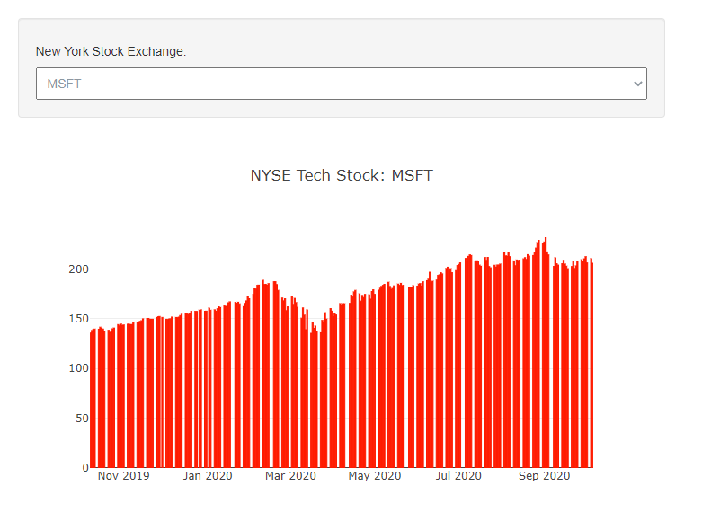
End Product

Slide 8
Challenges

Slide 9
Reflection
Things we wish we could have done or wish we had done better

